Slide 1
STOCK PRICE DATA ANALYSIS AND PREDICTION
PRESENTED BY
Team 12 SHIVI BHATT (001027605)
DHARMIK HARKHANI(001029591)
Data Science Engineering Method & Tools Dr. (Prof.) HANDAN LIU h.liu@northeastern.edu

Slide 2
INDEX
Introduction
Dataset Details
Data Analysis
Model Used
Target Variables
Metrics
Conclusion

Slide 3
Introduction
Stock price data analysis and prediction aims to predict the close price for the one of the top companies from the data set we have taken example of NYL & AAPL company, the dataset is available for 1970 to 2018 around 20 million of data, for predicting the score we filtered the data to 2017 year approx. 1.5 million of Data. This project we have ‘Close’ and ‘Adjusted Close Price’ as the target variable.

Slide 4
DATASET DETAILS
This dataset has the daily stock prices for a selection of several thousand stock tickers from NYSE and NASDAQ. This is historical stocks data from 1970 to 2018, this dataset has 20.97 million records (2 GB size), so model is applied using below two files - historical stocks - historical stock prices
Number of Attributes
historical stocks – 6
historical stock prices - 8
Dataset Link: https://www.kaggle.com/ehallmar/daily-historical-stock-prices-1970-2018

Slide 5
DATA ANALYSIS
Exploratory Data Analysis on All the Models
Removed NaN values
Visualized Data on several parameters
1.29 Million Data extracted from the huge data(20.9 Million) set to predict accuracy

Slide 6
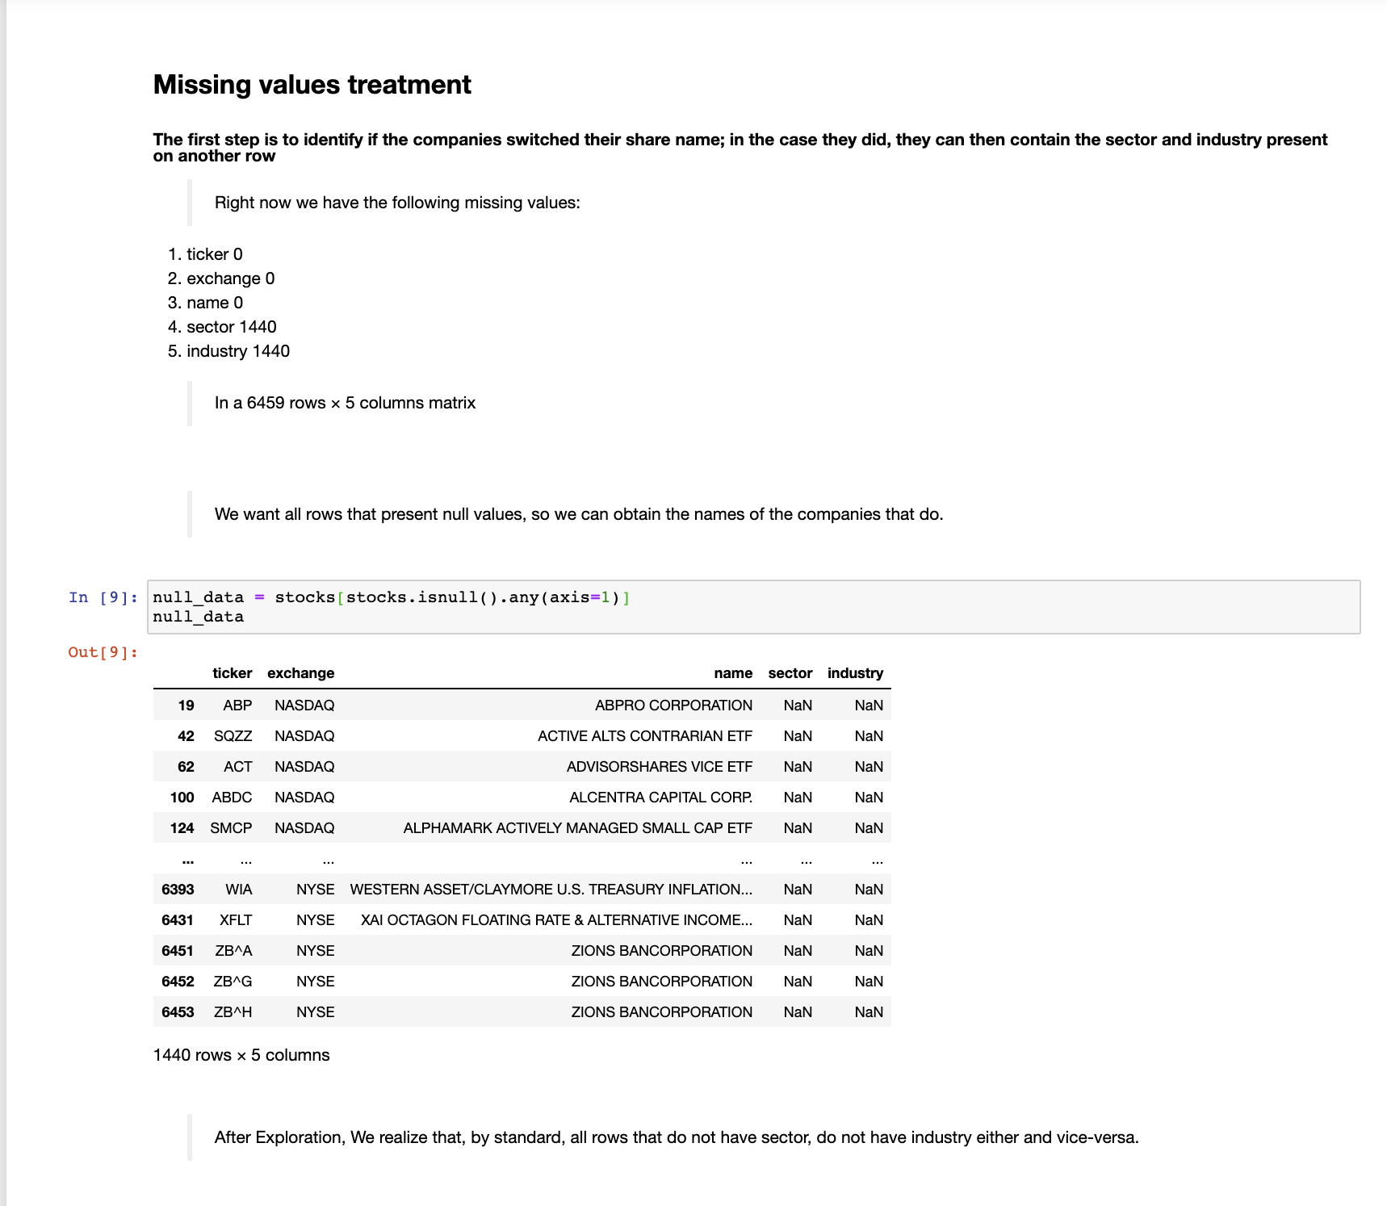
Place your screenshot here
VISUALIZATIONS

Slide 7
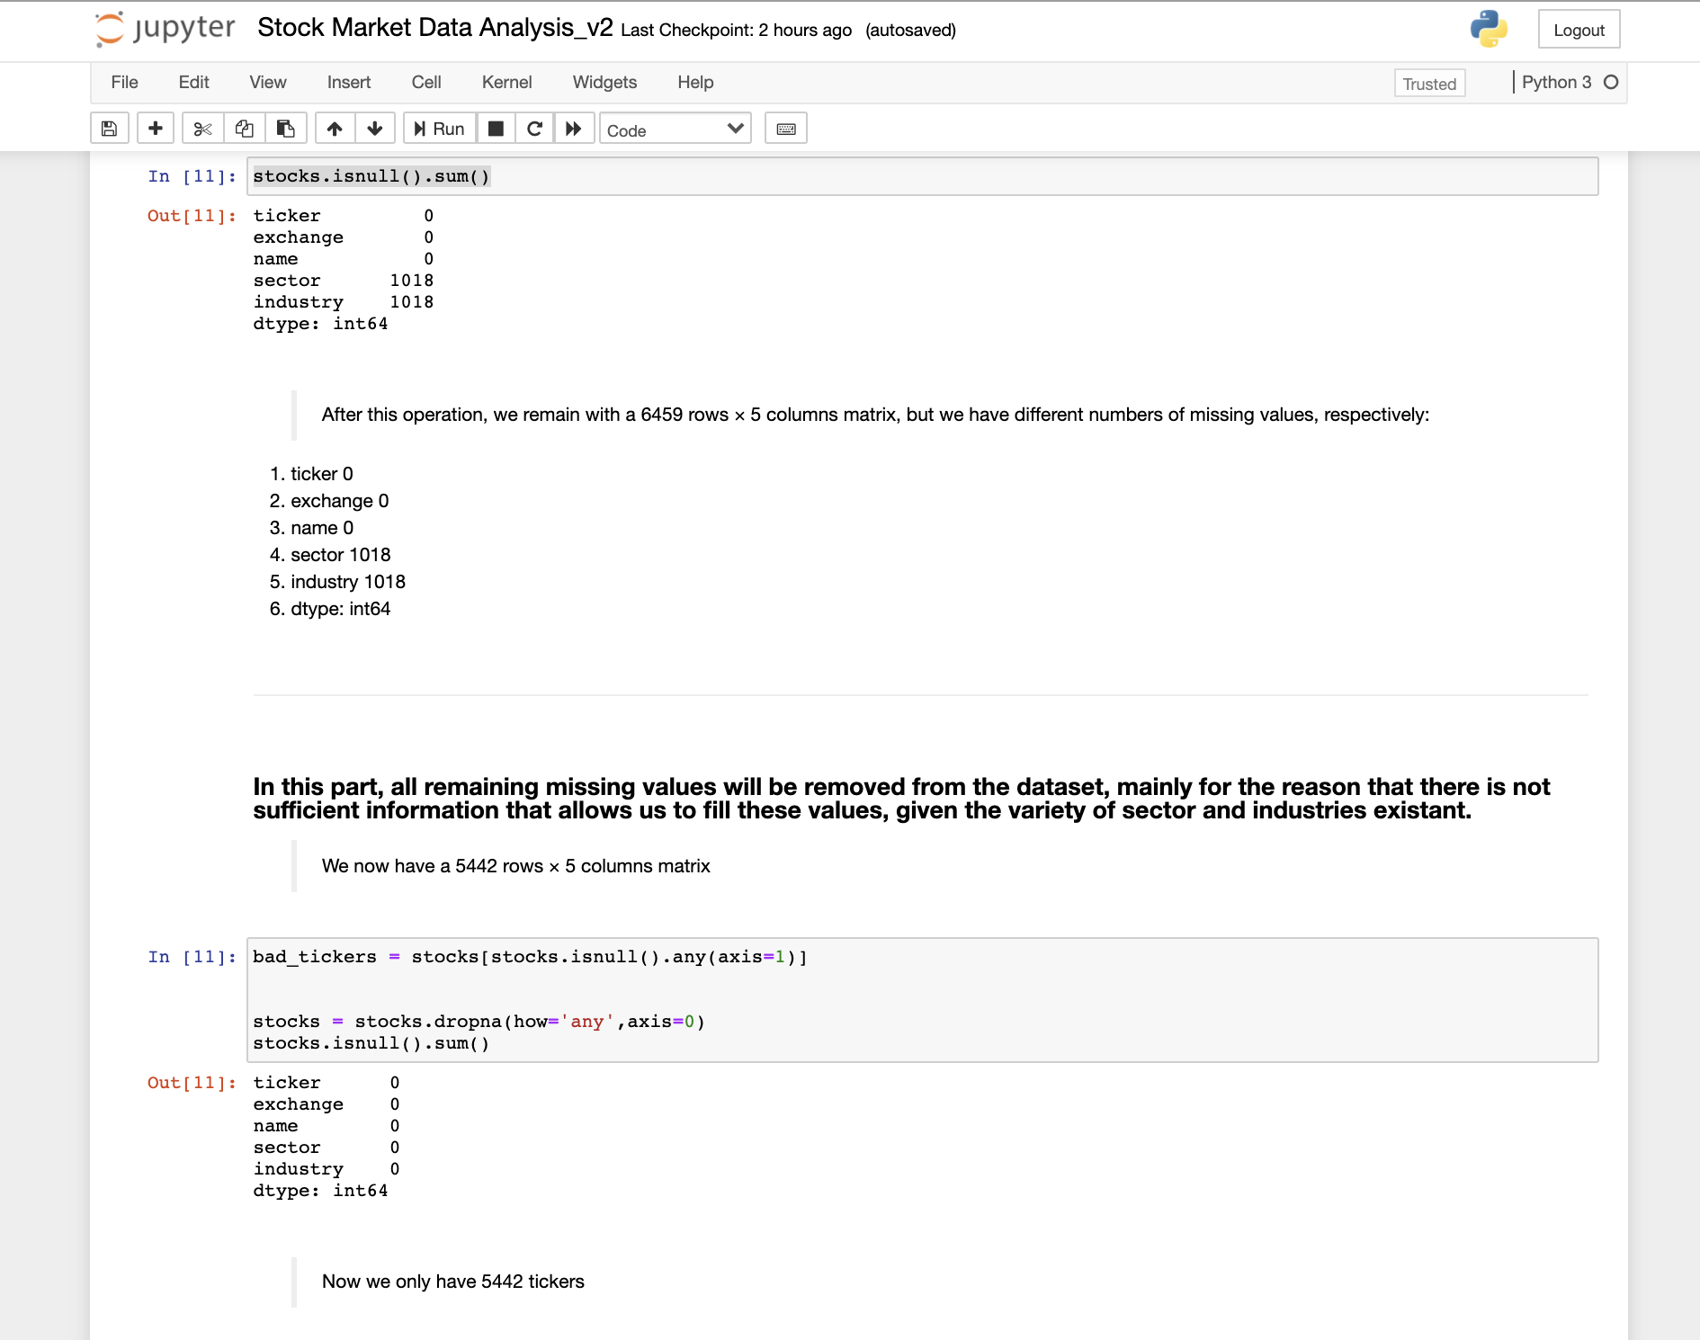
Place your screenshot here
VISUALIZATIONS – NAN VALUES REMOVAL

Slide 8
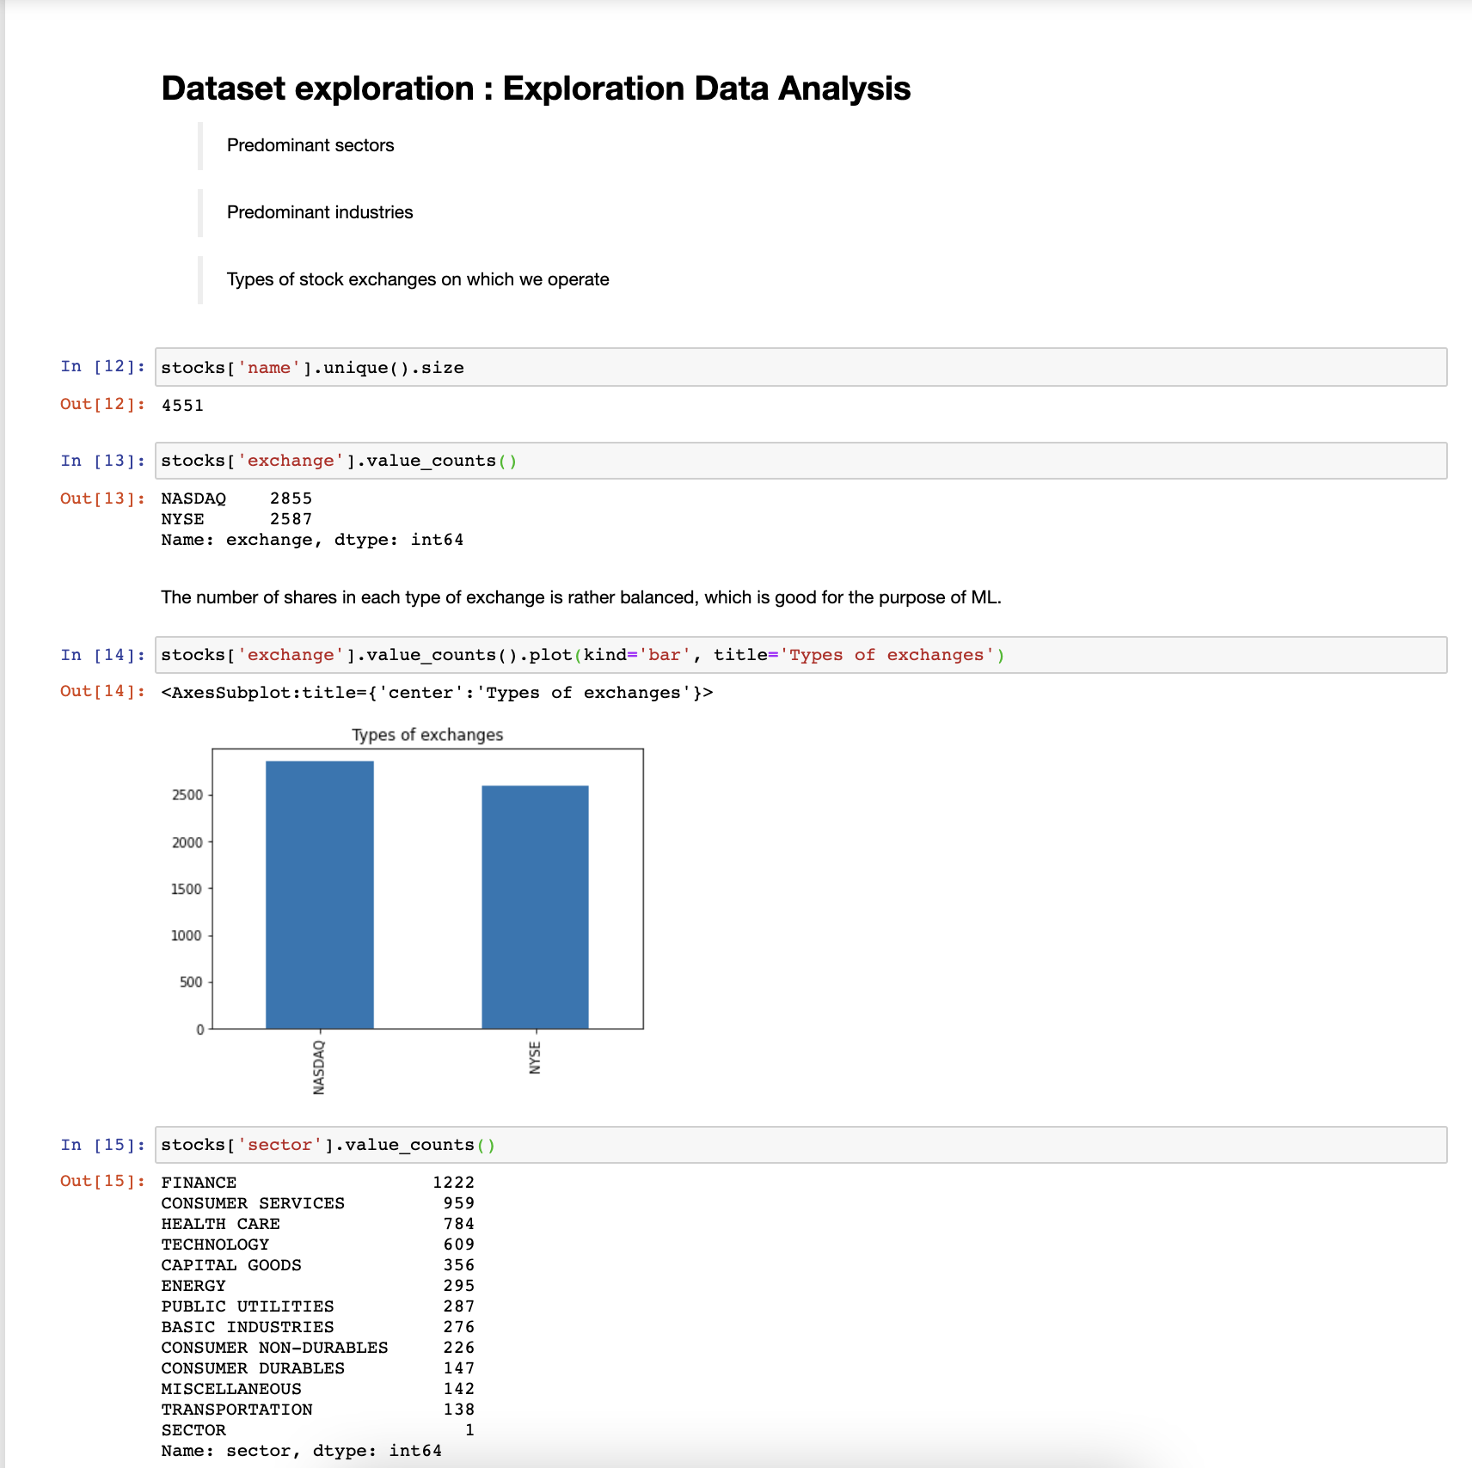
Place your screenshot here
VISUALIZATIONS – DATA EXPLORATION

Slide 9
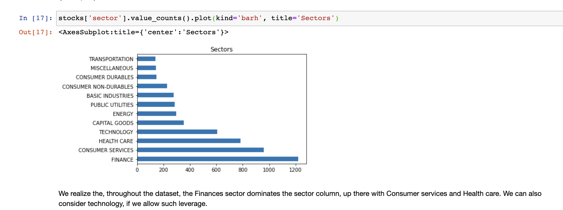
Place your screenshot here
VISUALIZATIONS – FINANCE SECTOR

Slide 10
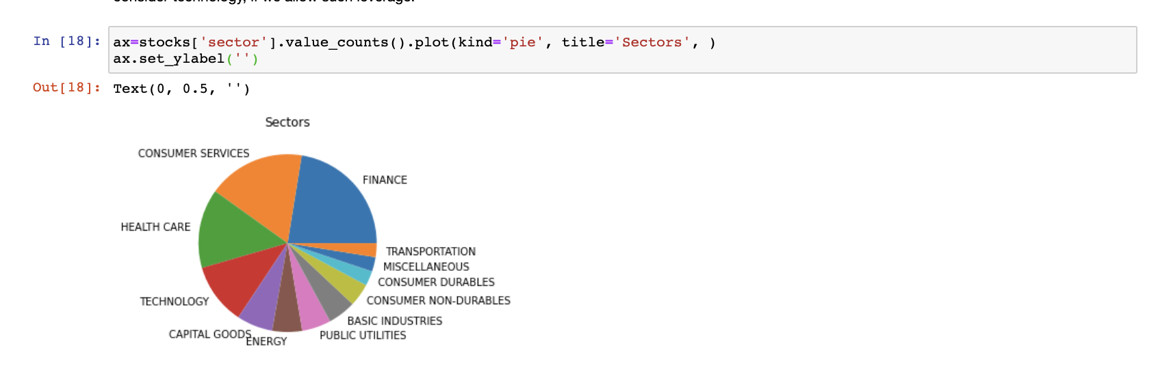
Place your screenshot here
VISUALIZATIONS – TOTAL SECTORS

Slide 11
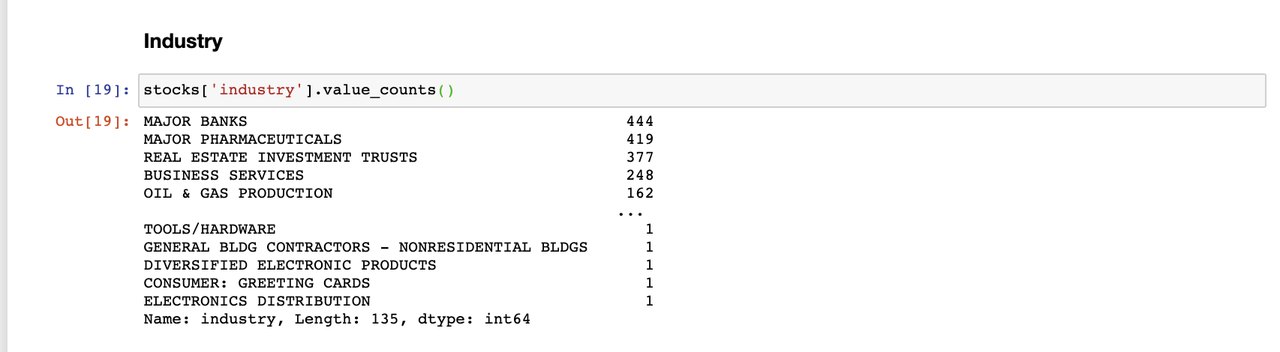
Place your screenshot here
VISUALIZATIONS – TOTAL INDUSTRY COUNT

Slide 12
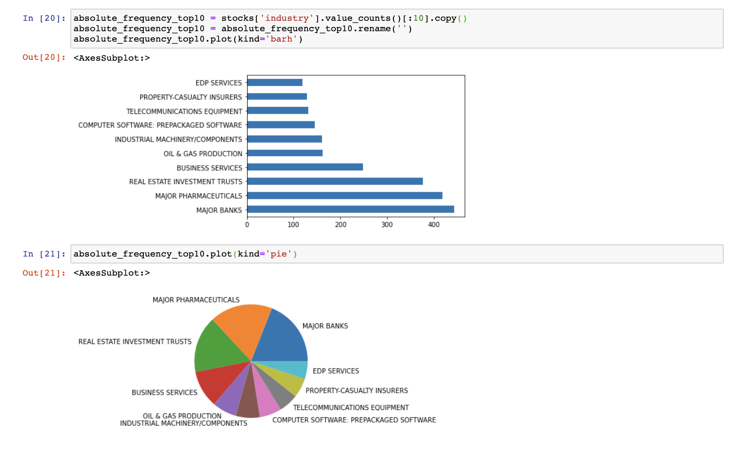
Place your screenshot here
VISUALIZATIONS – TOP 10 INDUSTRY

Slide 13
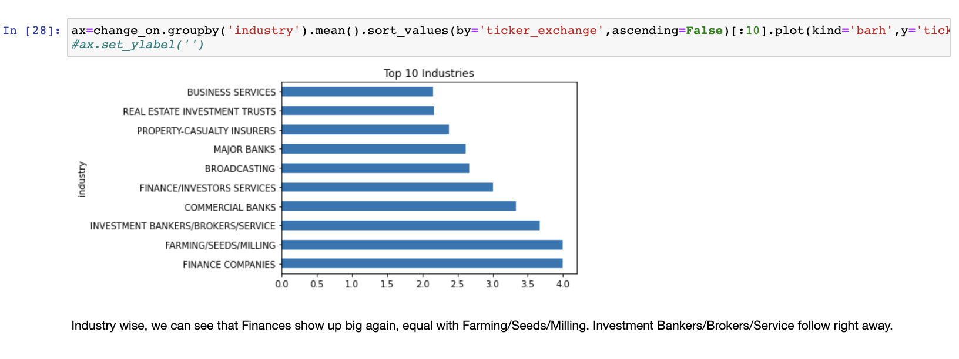
Place your screenshot here
VISUALIZATIONS – TOP 10 INDUSTRY SORTED BY TICKER-EXCHANGE

Slide 14
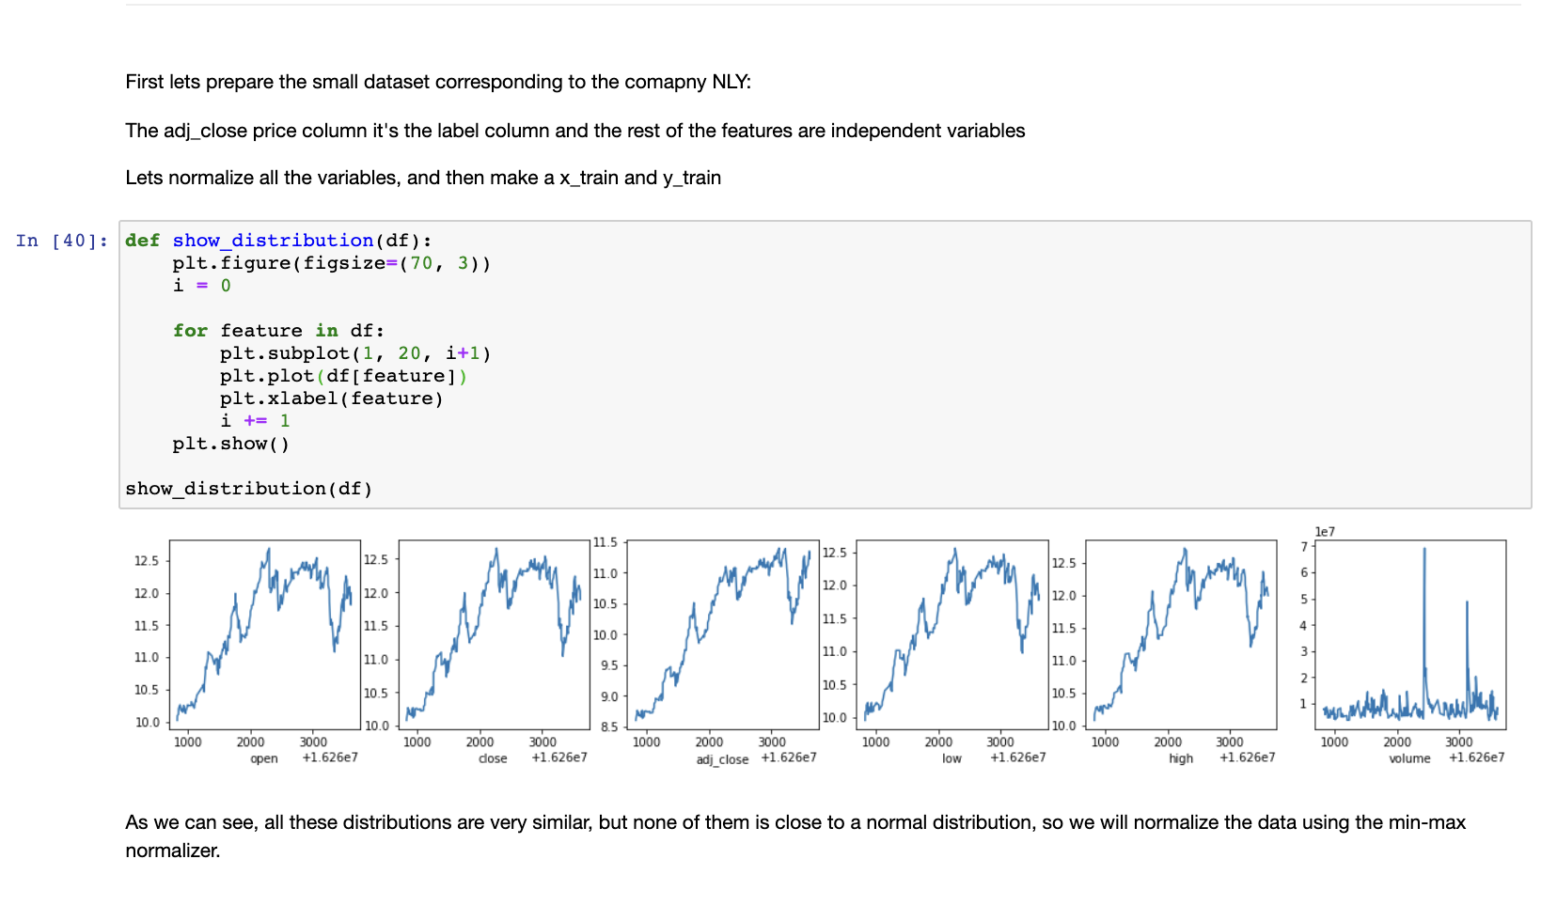
Place your screenshot here
VISUALIZATIONS – NLY COMPANY DISTRIBUTION

Slide 15
MODEL USED
Linear Regression
Decision Tree Regressor
RegressorGRU (Gated Recurrent Unit)
Recurrent Neural Network(LSTM – Long Short Term Memory)

Slide 16
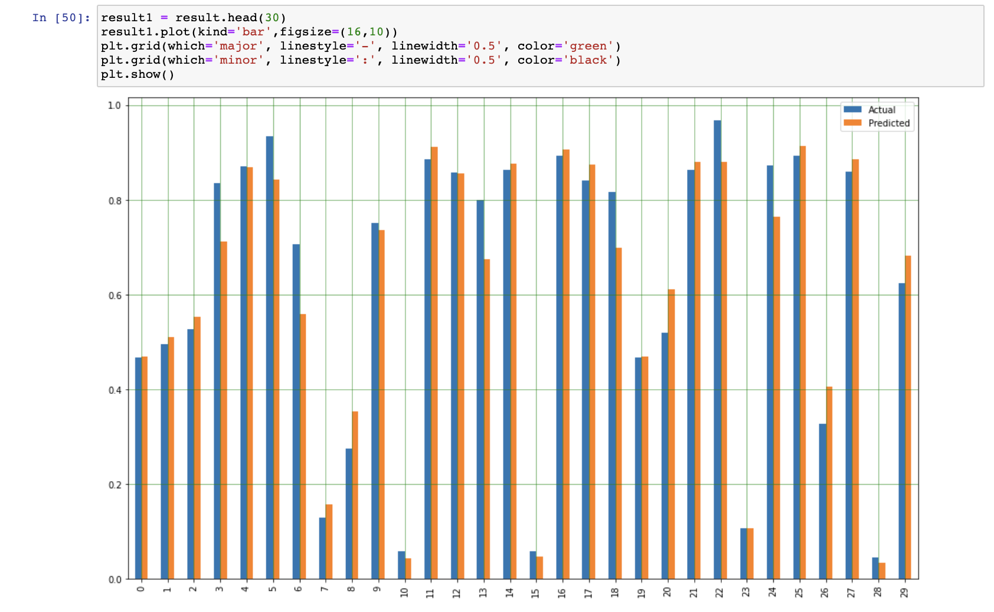
Place your screenshot here
LINEAR REGRESSION PREDICTED GRAPH

Slide 17
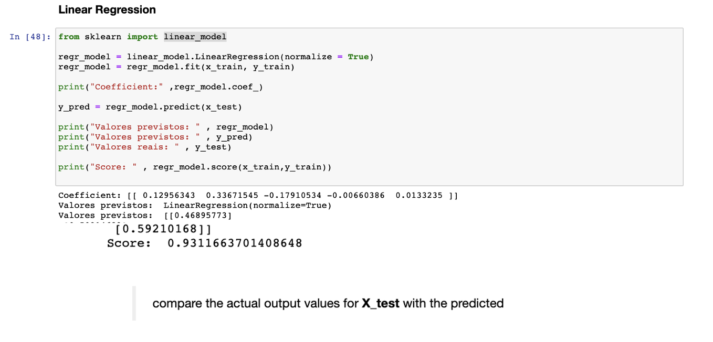
Place your screenshot here
LINEAR REGRESSION PREDICTED SCORE

Slide 18
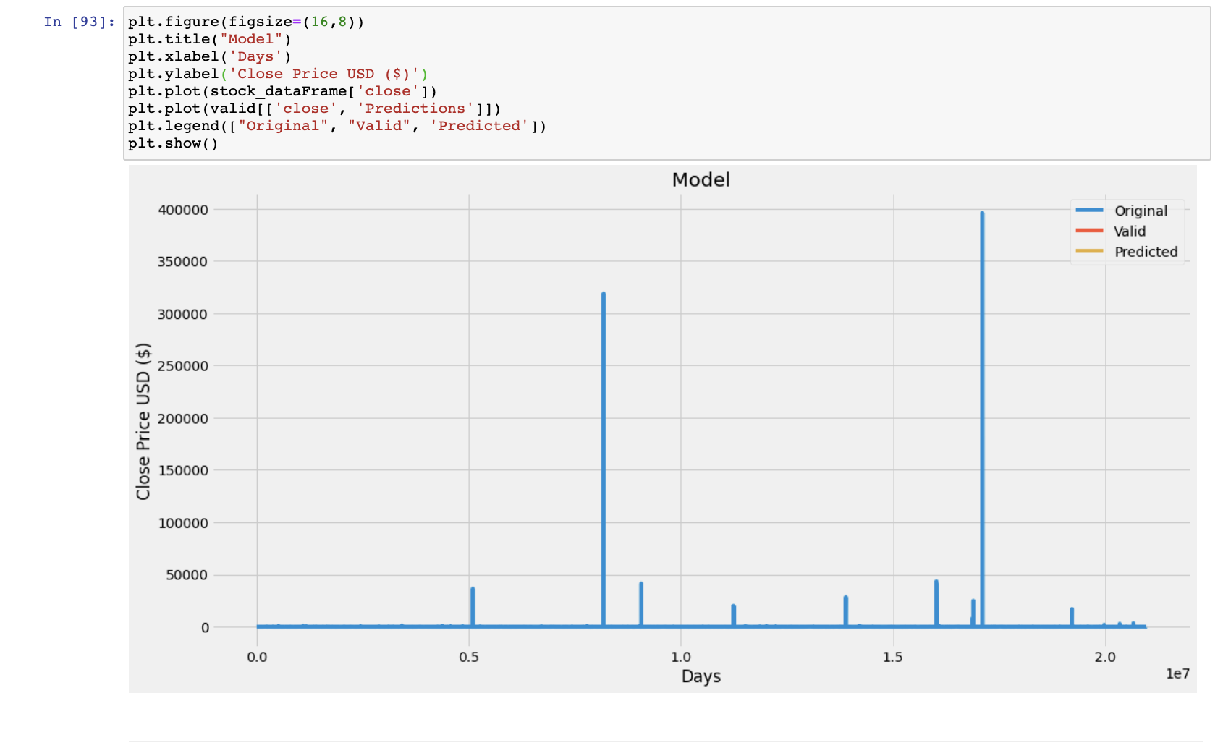
Place your screenshot here
DECISION TREE REGRESSOR PREDICTED GRAPH

Slide 19
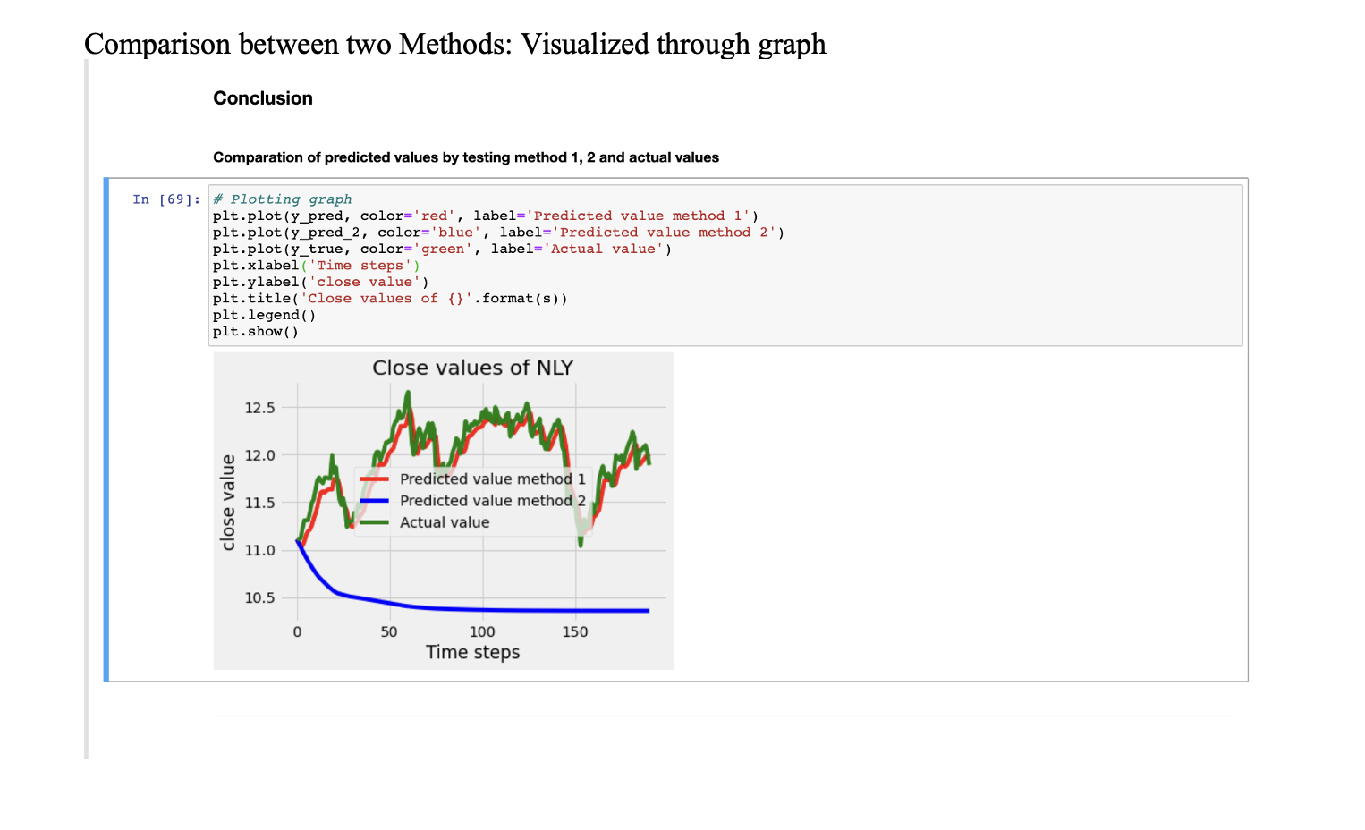
Place your screenshot here
REGRESSORGRU
(GATED RECURRENT UNIT) PREDICTED GRAPH USING TWO METHODS

Slide 20
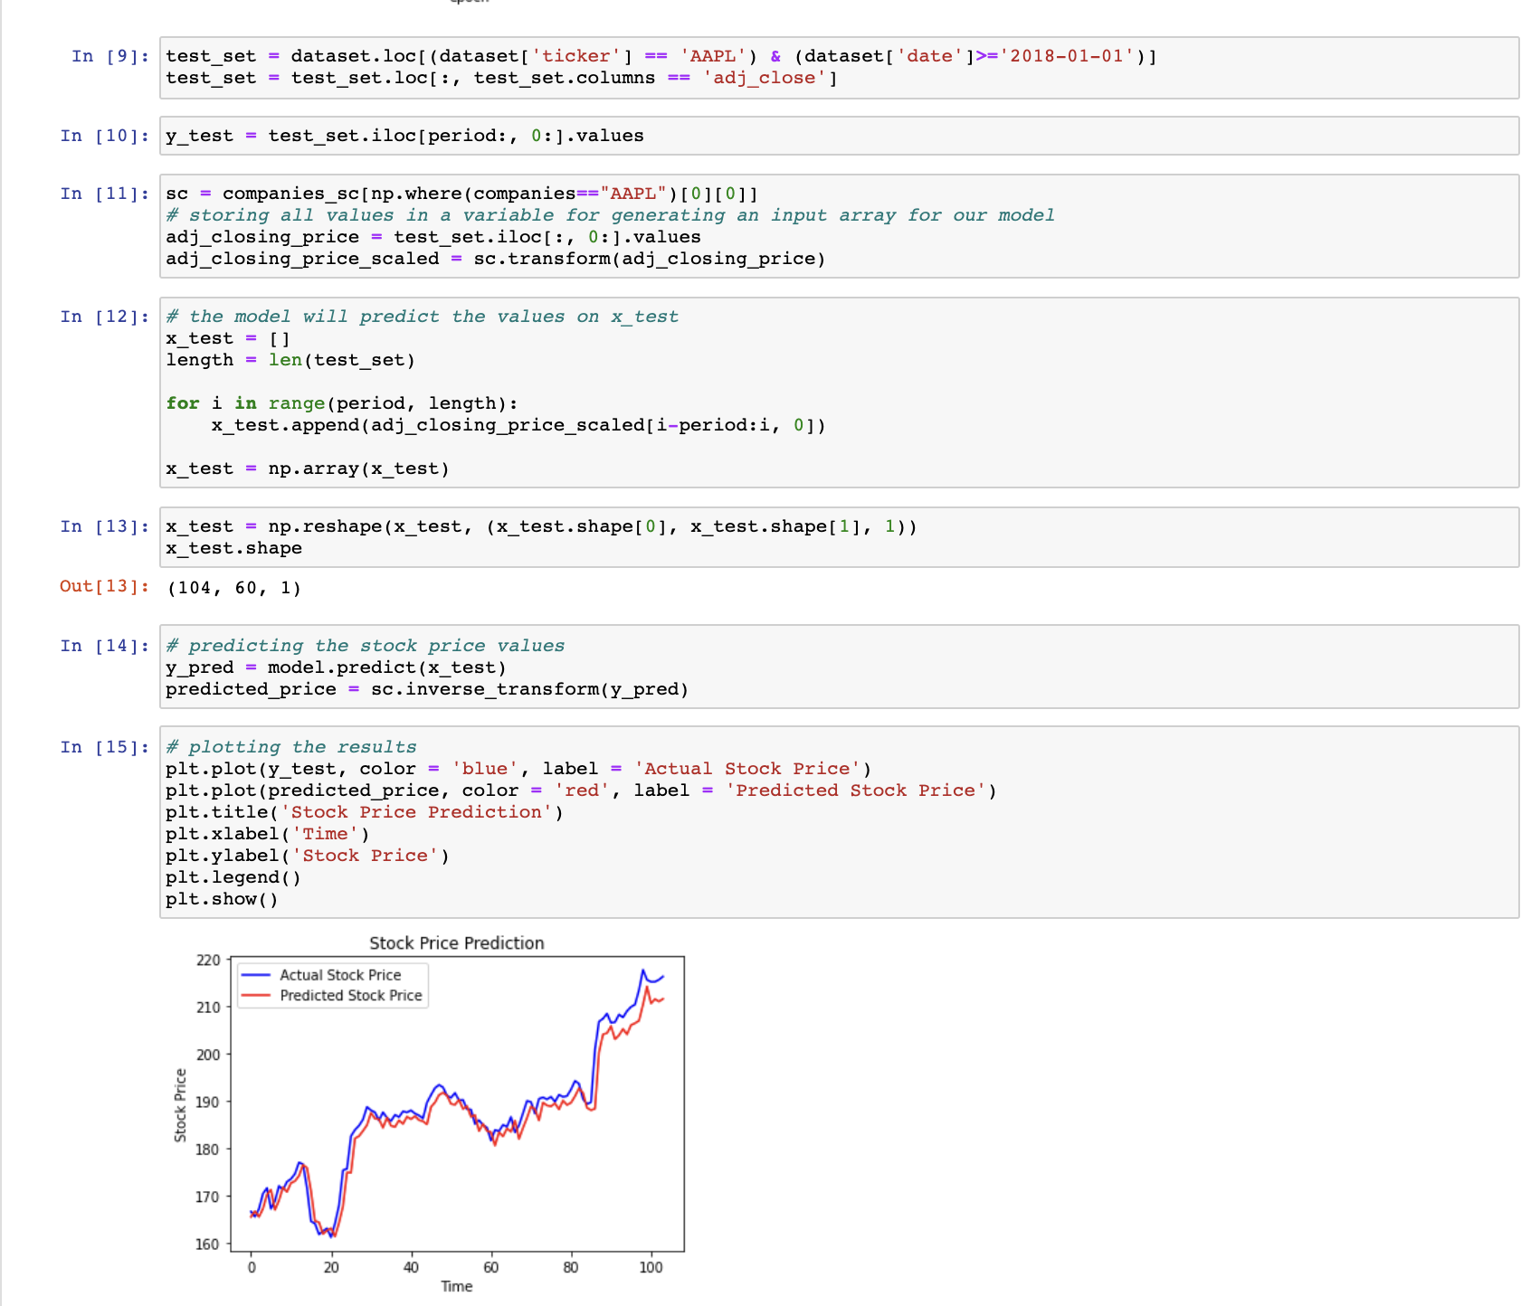
Place your screenshot here
LSTM STOCK PRICE PREDICTION

Slide 21
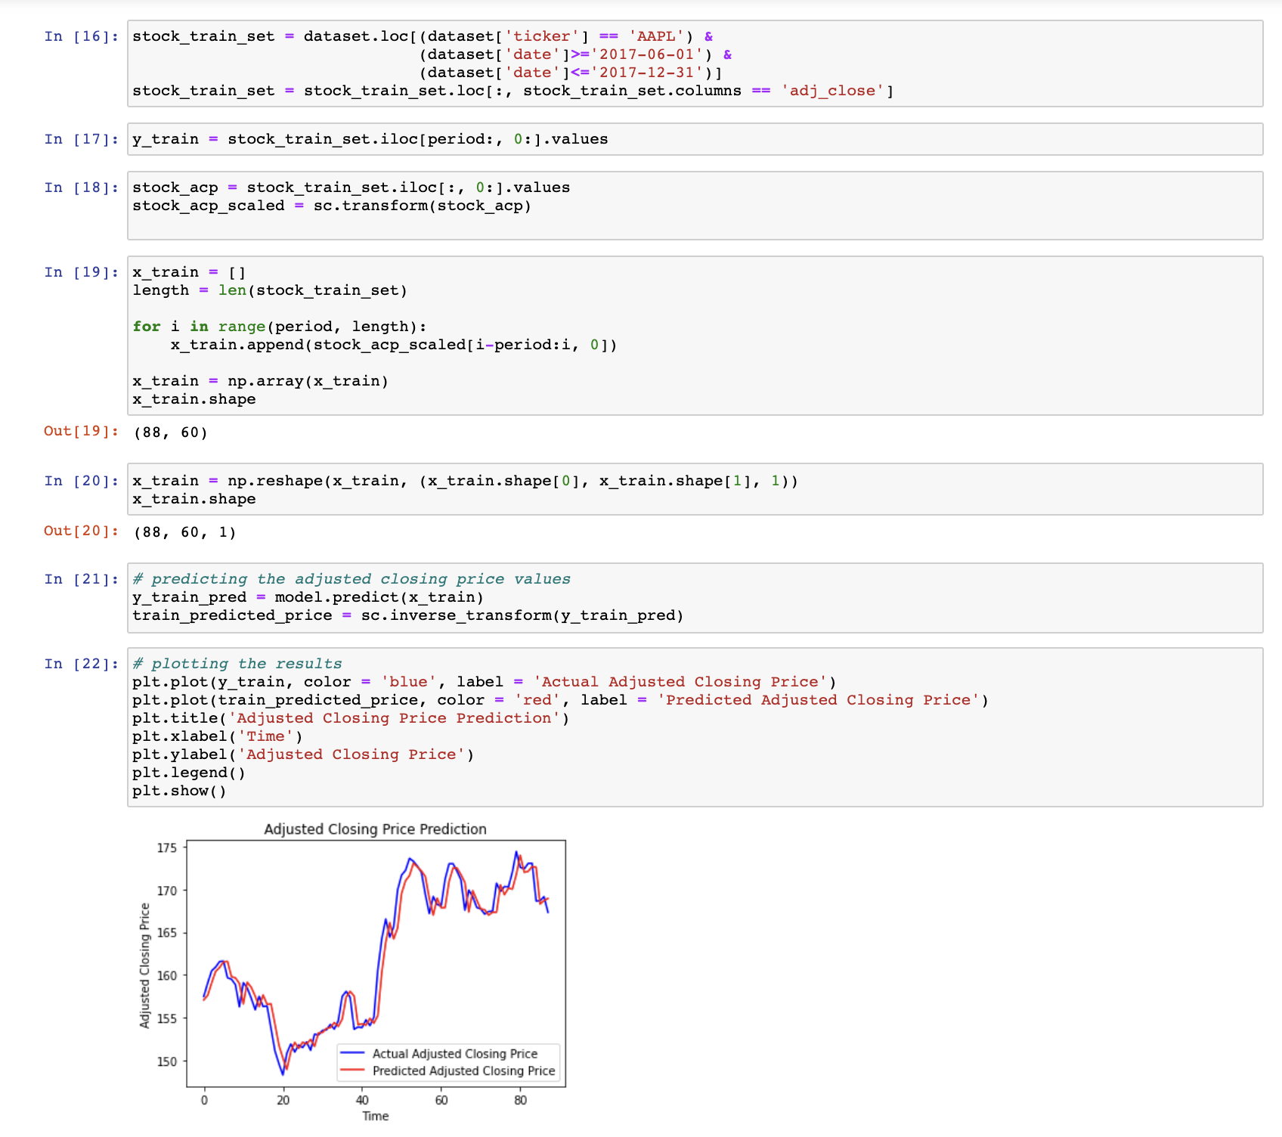
Place your screenshot here
LSTM STOCK ADJ CLOSE PRICE PREDICTION

Slide 22
TARGET VARIABLE
CLOSE PRICE - describe the final share price in the end of a day
ADJ_CLOSE - it´s a tricky column, describes the adjusted price of a share, that is normally different from the close price

Slide 23
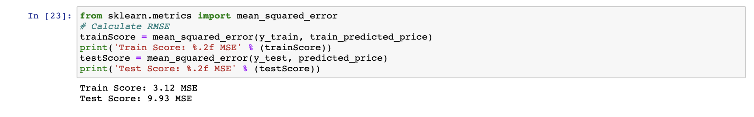
Place your screenshot here
METRIC - LSTM

Slide 24
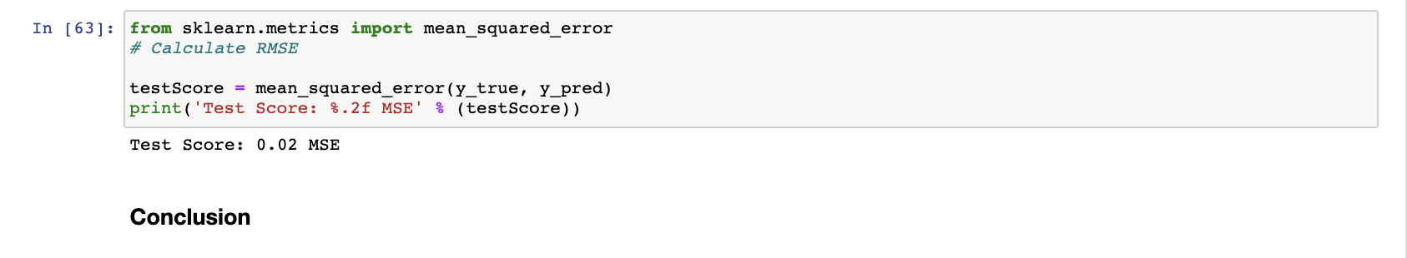
Place your screenshot here
METRIC - REGRESSORGRU

Slide 25
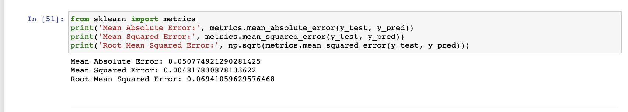
Place your screenshot here
METRIC – LINEAR REGRESSION

Slide 26
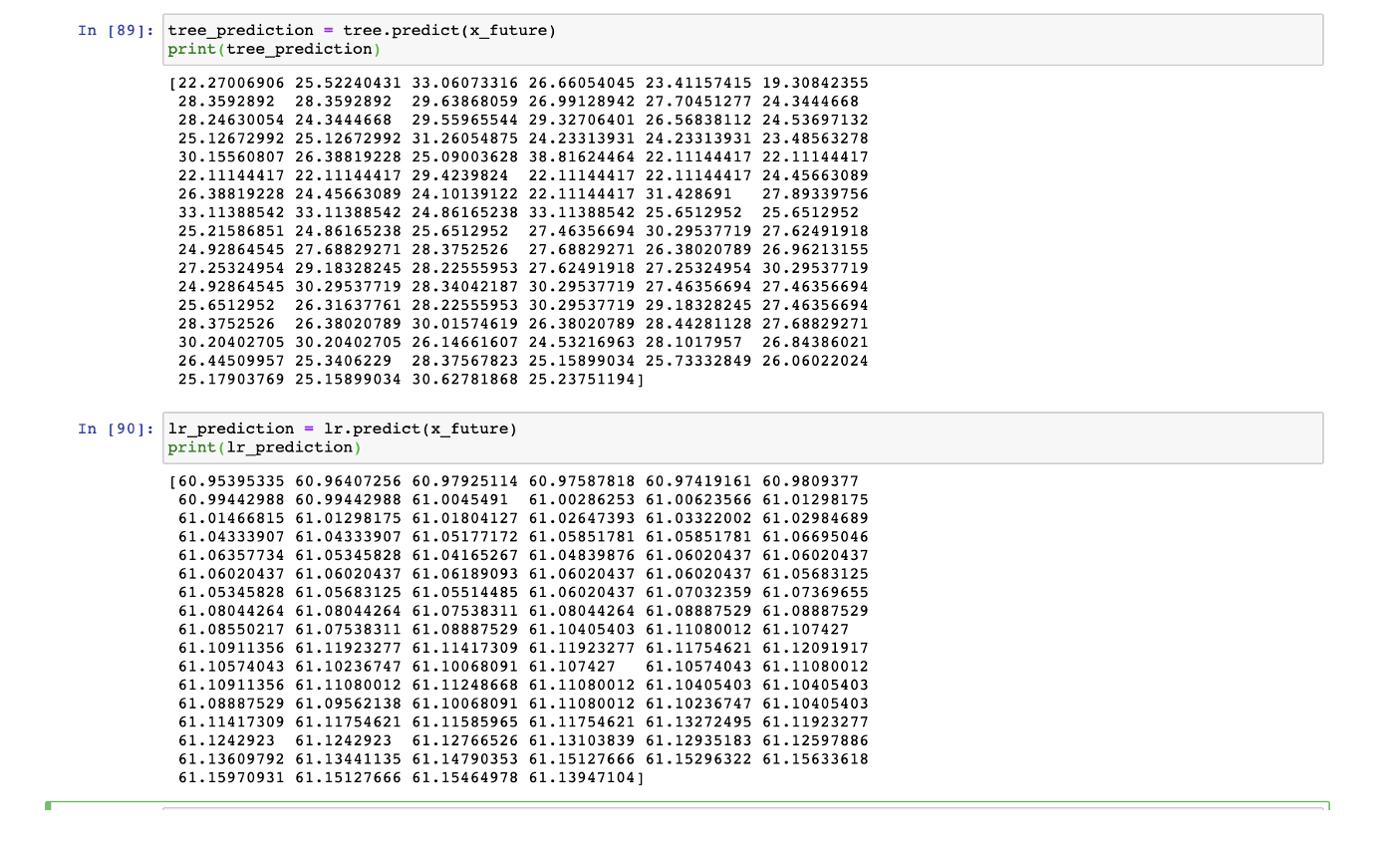
Place your screenshot here
PREDICTED VALUES – DECISION TREE REGRESSOR & LINEAR REGRESSION COMPARISION

Slide 27
CONCLUSION
With Accuracy Score of all the used algorithms, RegressorGRU (Gated Recurrent Unit) produced significant score of accuracy for predicting the Target variable (close)
With Accuracy Score of all the used algorithms, LSTM produced significant score of accuracy for predicting the Target variable (adj close)

Slide 28
REFERENCES
https://www.kaggle.com/thebrownviking20/intro-to-recurrent-neural-networks-lstm-gru
http://www.stat.yale.edu/Courses/1997-98/101/linreg.htm
https://scikit-learn.org/stable/modules/generated/sklearn.linear_model.LinearRegression.html
https://en.wikipedia.org/wiki/Gated_recurrent_unit
https://scikit-learn.org/stable/auto_examples/tree/plot_tree_regression.html
https://www.kaggle.com/guilhermeviveiros/predicting-stock-prices
https://www.kaggle.com/rishidamarla/stock-market-prediction-using-decision-tree
https://www.kaggle.com/piseykorn/kernel27b53324dd
https://www.kaggle.com/maimom/predict-adjusted-close-using-lstm
https://www.saedsayad.com/decision_tree_reg.htm#:~:text=Decision%20tree%20builds%20regression%20or,decision%20nodes%20and%20leaf%20nodes.
https://www.researchgate.net/publication/313408030_A_Review_on_Prediction_of_Stock_Market_using_Various_Methods_in_the_Field_of_Data_Mining#:~:text=Objectives%3A%20In%20the%20current%20emerging,data%20available%20on%20the%20market.

Slide 29
THANKS!
Any questions?
You can find me at
Shivi
bhatt.s@northeastern.neu.edu
Dharmik
harkhani.d@northeastern.neu.edu

